Slide 1

Why Love?
1 Corinthians 13
Dr. Rick Griffith • Crossroads International Church Singapore
cicfamily.com & BibleStudyDownloads.org

Slide 2
Black

Slide 3
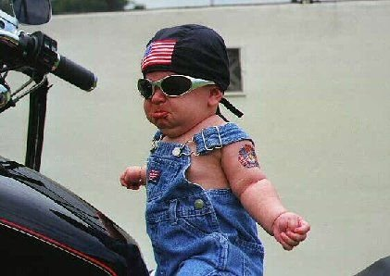
A little knowledge can be dangerous

Slide 4

Our Past 4 Messages
1 Cor. 12
• Intro
• Speaking Gifts
• Serving Gifts
• Unity & Diversity

Slide 5
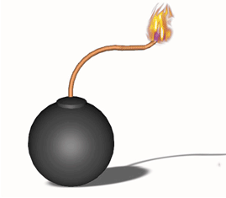
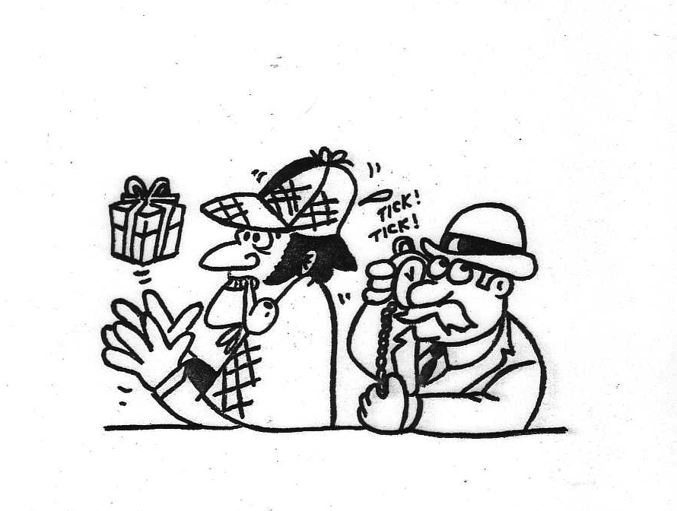
Dangers of Studying Gifts
13

Slide 6

Overview of 1 Cor. 12–14
1 Cor. 12
• Intro
• Speaking Gifts
• Serving Gifts
• Unity & Diversity
1 Cor. 13
• Love
1 Cor. 14
• Prophecy
• Tongues

Slide 7

The Fruit of the Spirit
xliii

Slide 8



Gifts versus Fruit of the Spirit
xlii
Gifts | Fruit
Abilities | Christ-likeness
Relate to service | Relate to character
Means to an end | The end itself
What a Christian has | What a Christian is

Slide 9
Gifts versus Fruit of the Spirit
xlii
Gifts | Fruit
Plural: many | Singular: one (love)
Often misused in the church | Rarely misused in the church
No believer possesses all | Every believer should strive for all
Will cease (temporary) | Will last (permanent)

Slide 10

Today's Key Idea
The most vital ingredient in using our gifts is love.
But why do we need to use our gifts with love?

Slide 11
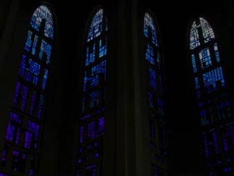
I. Love is superior to gifts (1-3).

Slide 12
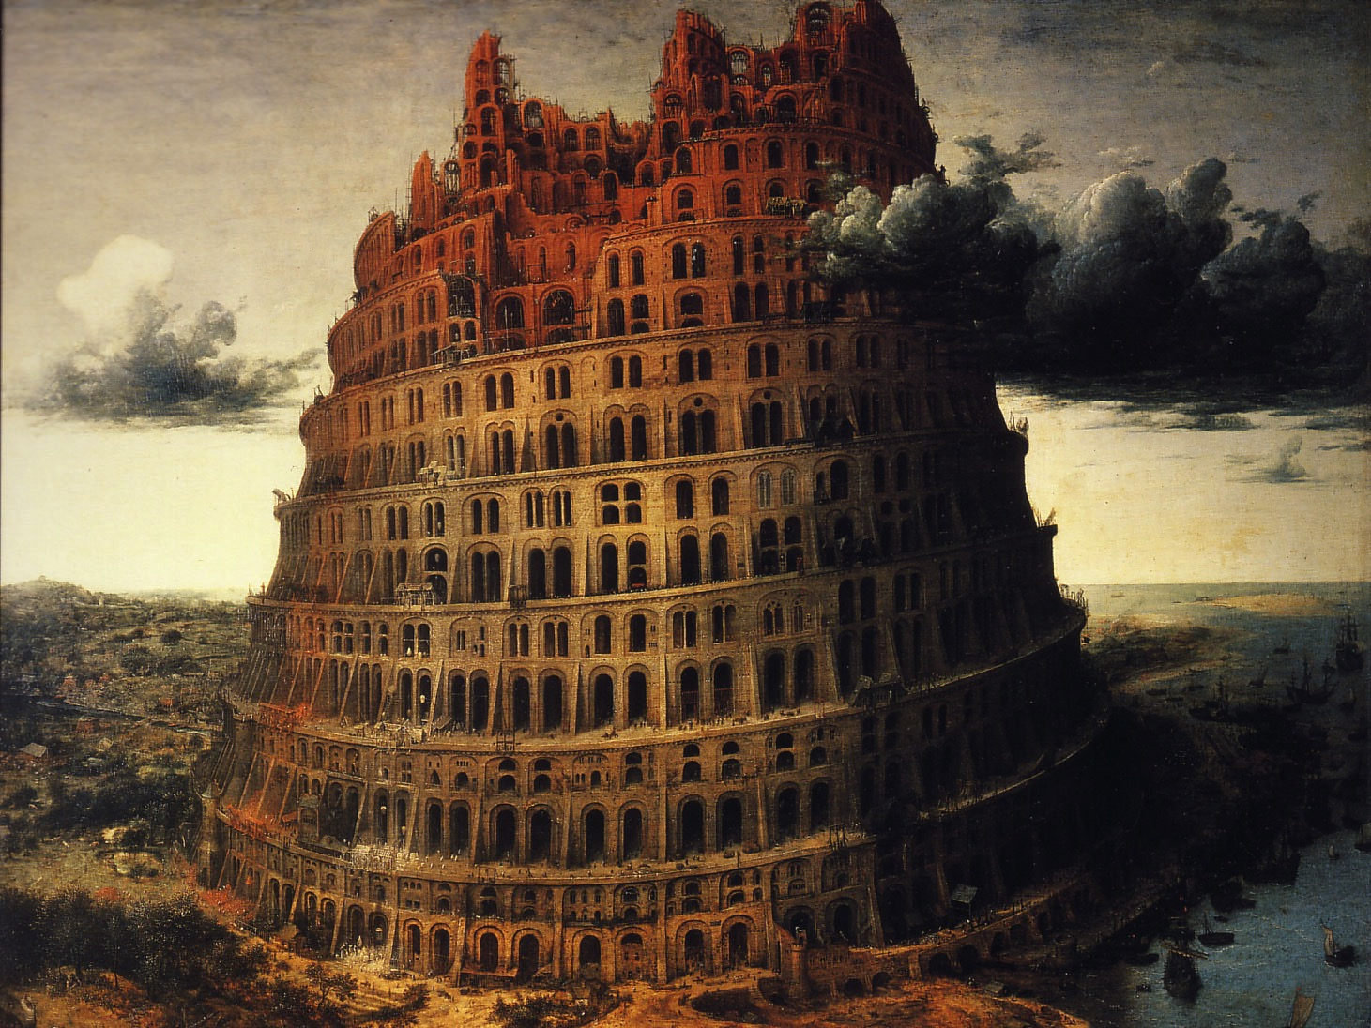
Tongues used to the max without love produces nothing (1).
"If I speak with the tongues of men and of angels, but have not love, I am a noisy gong and a clanging cymbal"

Slide 13
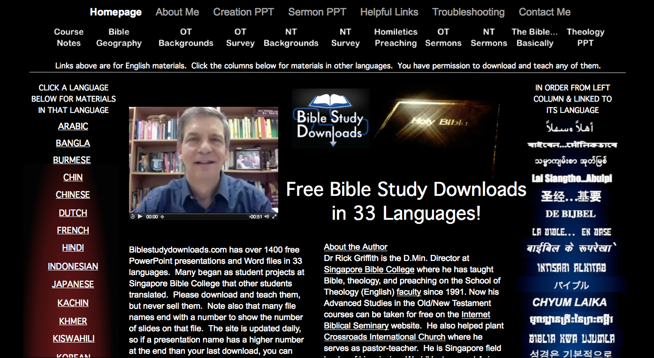
biblestudydownloads.com
7

Slide 14
Black

Slide 15
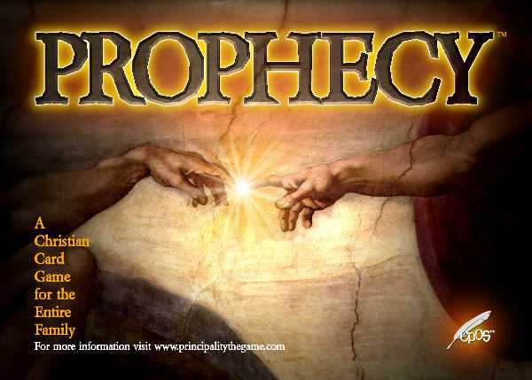
Prophecy without love is worthless to edify others (2a)
"If I have the gift of prophecy…"

Slide 16

Wisdom that knows all previously hidden doctrines but without love is worthless to edify others (2b)
"…and can fathom all mysteries…"

Slide 17
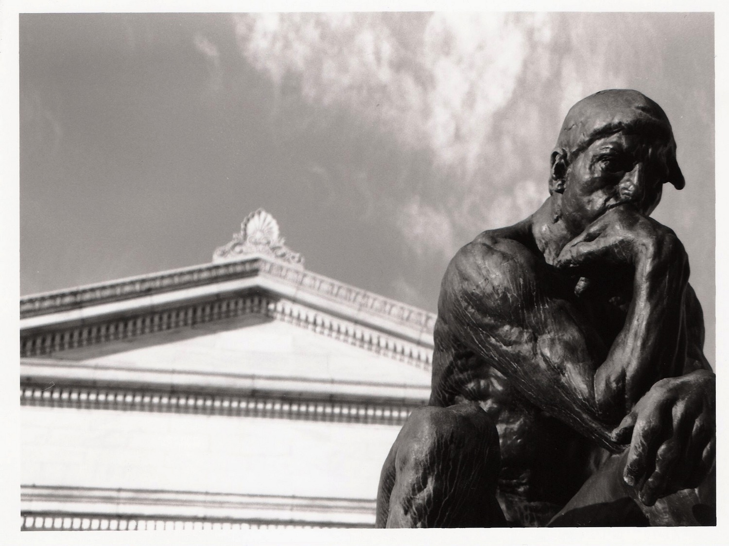
Knowledge that knows all facts but without love is worthless to edify others (2c)
"…and all knowledge…"

Slide 18
Black

Slide 19
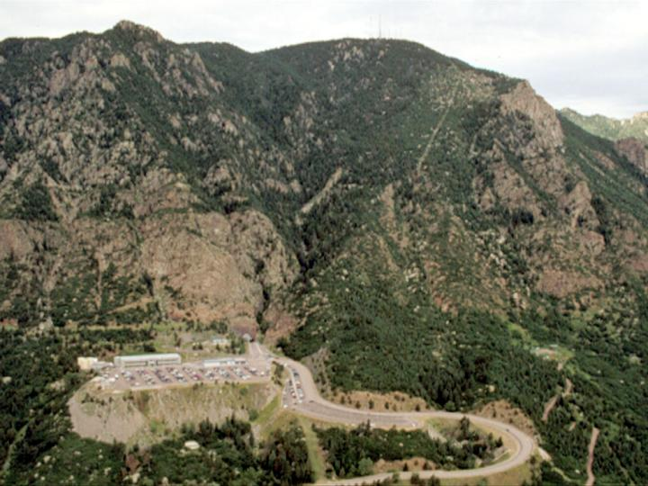
Faith that can move mountains but without love is worthless to edify others (2d).
"…and if I have a faith that can move mountains but have not love,
I am nothing…" (NIV)

Slide 20
Black

Slide 21
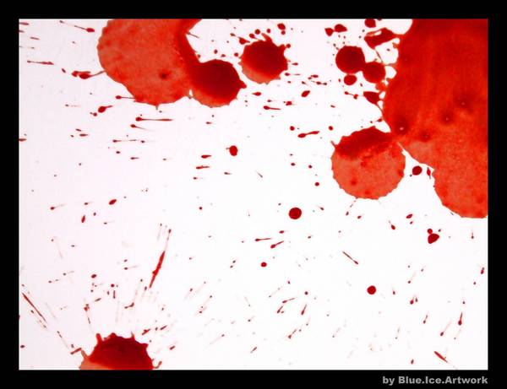
Giving
"…and if I give my body to be burned but have not love,
I am nothing…" (NIV)
"The Blood of the Martyrs is the seed of the Church"
-Tertullian-

Slide 22
Black

Slide 23
INDIA
"…and if I give my body to be burned but have not love,
I am nothing…" (NIV)
"The Blood of the Martyrs is the seed of the Church"
-Tertullian-

Slide 24
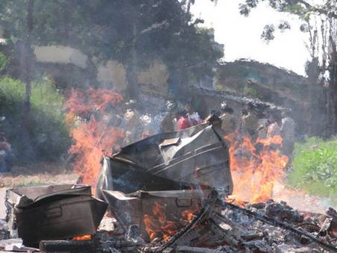

Slide 25
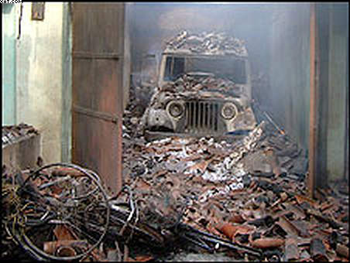

Slide 26
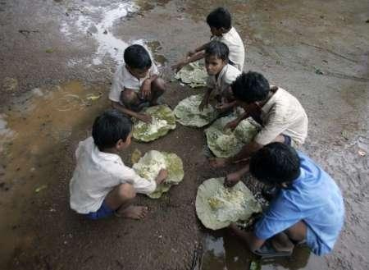

Slide 27
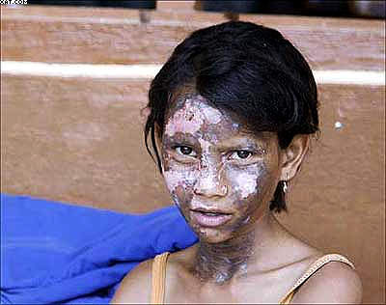

Slide 28
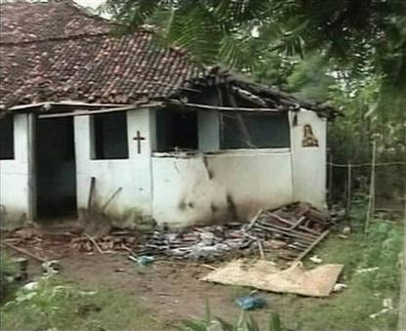

Slide 29
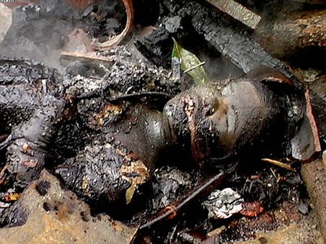

Slide 30
Pray
- For a Revival
- That the Love of Christians May Shine
- For Perseverance, Endurance of The Saints
- For Unity of the Church in India
- Against Retaliation by the Christians

Slide 31
Black

Slide 32
I. Love is superior to gifts (1-3).

Slide 33




Our Vision is to…
Love God
Love the Church
Love the Nations
Notes:
• Love God
Where it starts—and ends—is in our call to LOVE. As Paul noted, “The greatest of these is love” (1 Cor. 13:13).
What is the most important thing we do as a church? It begins with loving the God who loves us.
• Love Church
Do you genuinely love him? If you don’t, then nothing else you do counts, really.
The second thing He said right after this: to love your neighbor as yourself.
• Love Nations
But who is your neighbor? It starts right here in the body—to love the church—but then it extends from this “close neighbor” to those who are out of the reach of this fellowship where we love the nations. Our leadership is committed to make all that we do revolve around one of these three priorities.
33

Slide 34
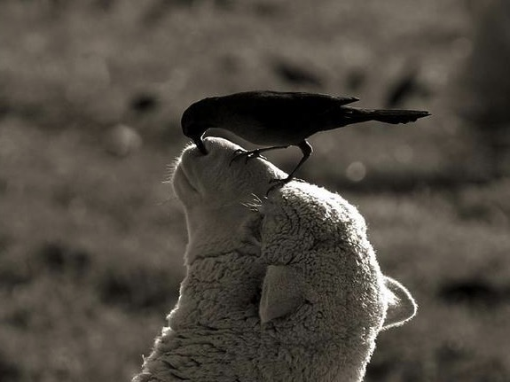
II. Love benefits others (4-7).

Slide 35

Relational Aspects of Love (4-7)
Love benefits others both passively and actively
(4a-b):
Passively patient
Actively kind

Slide 36
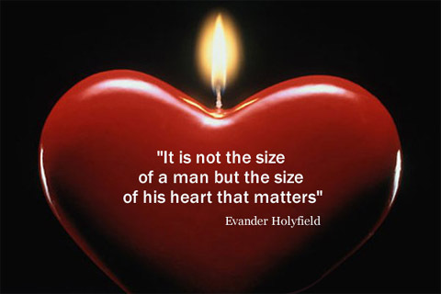
Heart Size

Slide 37
Relational Aspects of Love (4-7)
Love doesn't hurt others in seven negative ways (4c-5):
Envy
Love benefits others both passively and actively
(4a-b):
Passively patient
Actively kind

Slide 38
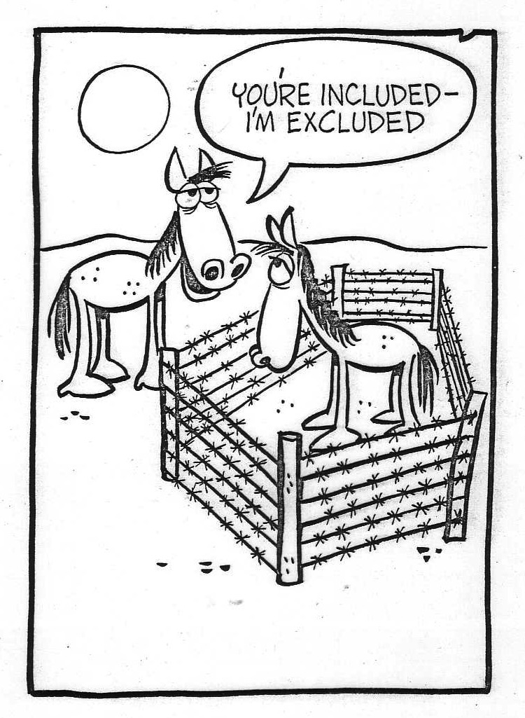
Don't feel inferior about your gift!

Slide 39
Relational Aspects of Love (4-7)
Love doesn't hurt others in seven negative ways (4c-5):
Envy
Boasting
Pride
Love benefits others both passively and actively
(4a-b):
Passively patient
Actively kind

Slide 40
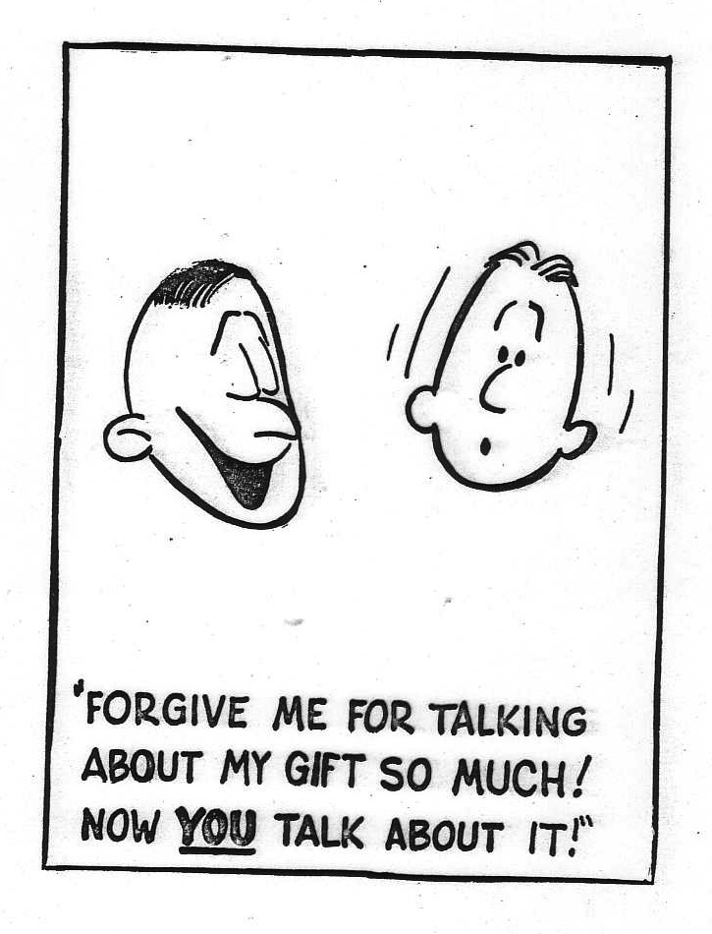
Don't think highly of your gift!

Slide 41
Relational Aspects of Love (4-7)
Love doesn't hurt others in seven negative ways (4c-5):
Envy
Boasting
Pride
Behaving improperly
Selfish
Irritable
Unforgiving
Love benefits others both passively and actively
(4a-b):
Passively patient
Actively kind

Slide 42

Love knows the right things to get happy about (6).
It does not rejoice about injustice…
… but rejoices whenever the truth wins out

Slide 43

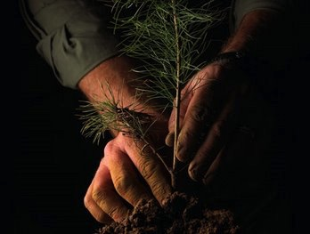

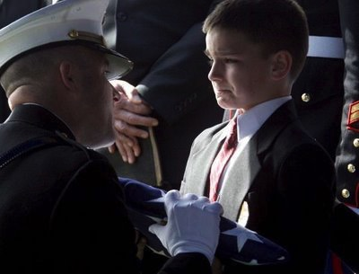
Love doesn't give up on others (7)
"endures"
"hopes"
"believes"
"perseveres"
Notes:
"Love never gives up, never loses faith, is always hopeful, and endures through every circumstance" (NLT)

Slide 44

III. Love outlasts gifts (8-13).
"Love never fails…"

Slide 45
Gifts are temporary and partial
8 Love never fails. But where there are prophecies, they will cease; where there are tongues, they will be stilled; where there is knowledge, it will pass away.
9 For we know in part and we prophesy in part,
10 but when perfection comes, the imperfect disappears.
to teleion (Gr)
1 Corinthians 13:8-12 NIV

Slide 46
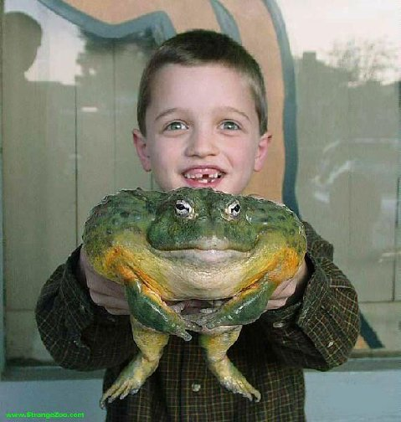
To teleion is a mega issue!

Slide 47
Black

Slide 48
1 Corinthians 13:8-13
16
______________________________________________________________________________
Crucial Questions Canon (Bible) Rapture Body (Church)
______________________________________________________________________________
13:8 What is the nature of:
a) prophecy & knowledge? revelatory non-revelatory revelatory
b) tongues? confirmatory non-confirmatory confirmatory
When do these gifts cease? with canon at Christ's coming with canon
13:10 What is to teleion? the "complete" the "perfect" the "mature"
(the canon) (Christ's coming) (the body)
13:11 What does growth to before and after before and after before and after
manhood represent? completed canon Christ's coming body's maturity
(shown by canon)
13:12 What are partial and before and after before and after before and after
full sight and knowledge? completed canon Christ's coming body's maturity
(completed by
parousia)
________________________________________________________________________________
Robert L. Thomas, JETS (1974): 81-89

Slide 49
The Canon View of 1 Corinthians 13:8-13
16
1. The Canon View sees to teleion as "the complete, the totality," referring to "the completed Scriptures." Therefore, prophecy, knowledge and tongues ceased before the New Testament was finished and are not existing today.
Strengths
Weaknesses
a.
Revelational knowledge context (vv. 8-9).
a.
Irreconcilable with Christ's coming (the parousia) in verse 12.
b.
Confirmatory nature of tongues
(cf. 14:22).
b.
The context does not refer to a completed New Testament. It's also doubtful that Paul ever envisioned one.
c.
Contrasts with partial nature of prophecy and knowledge.
c.
"The whole" (to ek pantos) better contrasts "partial" than to teleion in that both are quantitative.
d.
to teleion often means "complete."
e.
"Complete" best contrasts "partial" (v. 10).
Robert L. Thomas, JETS (1974): 81-89

Slide 50
The Rapture View of 1 Corinthians 13:8-13
17
2. The Rapture View sees to teleion as "the perfect" (as opposed to "the complete" above), referring to the coming of Christ at the Rapture. Therefore, prophecy, knowledge and tongues will cease only when Christ comes and exist today as legitimate gifts.
Robert L. Thomas, JETS (1974): 81-89
Strengths
Weaknesses
a.
Adequately explains "knowing fully" in verse 12.
a.
Inadequately explains the gradual maturing development of verse 11.
b.
"Face to face" (v. 12) well describes seeing Christ at His coming (cf. 1 Cor. 1:7) and has OT parallels to seeing God personally.
b.
Fails to recognize the distinctions between the revelatory nature of prophecy and knowledge and the confirmatory nature of tongues (cf. 14:22)
c.
"Perfect" well describes the condition at the parousia (Rapture).
c.
Paul never uses to teleion as "the perfect" in the absolute sense.
d.
to teleion often means "perfect" in secular, philosophical Greek (e.g. Plato) as well as James 3:2.
d.
"Perfect" (a qualitative term)
poorly contrasts with "partial"
(a quantitative term, v. 10).

Slide 51
The Body View

Slide 52

Robert L. Thomas…
"It pictures the Christian church collectively, growing up as one body, beginning with its birth, progressing through different stages of development during the present [relative maturity in v. 11] and reaching maturity at the return of Christ [ultimate maturity in v. 12]."
Robert L. Thomas, JETS (1974): 81-89

Slide 53
The Body View of 1 Corinthians 13:8-13
16
3. The Body View sees to teleion as "the mature," referring to the maturity of the body of Christ. "It pictures the Christian church collectively, growing up as one body, beginning with its birth, progressing through different stages of development during the present [relative maturity, v. 11] and reaching maturity at the parousia [ultimate maturity, v. 12; Thomas, 86]." By using the ambiguous term to teleion Paul left open two possibilities, the church as: (1) relatively complete at the completion of the NT or (2) ultimately complete at Christ's return. This view ultimately comes to the same conclusion as the Canon View.
Strengths
Weaknesses
a.
Parallel 1 Cor. passages contrast to teleion (meaning "mature") with "babes, child"
(nepios; 2:6 & 3:1; 14:20; cf. Heb. 5:13-14)
a.
"Mature" (a qualitative term) poorly contrasts "partial" (a quantitative term, v. 10).
b.
Consistent with both the relative maturity of v. 11 and the absolute maturity of v. 12.
b.
Assigns a double sense for to teleion which may be unlikely.
c.
Best fits the "body and gifts context" of 1 Cor. 12-14 and the striking similarity to Eph. 4:1-16.
d.
Has the same strengths of a., b., & c. in the Canon View.
Robert L. Thomas, JETS (1974): 81-89

Slide 54
Two Illustrations
11 When I was a child, I talked like a child, I thought like a child, I reasoned like a child. When I became a man, I put childish ways behind me.
12 Now we see but a poor reflection as in a mirror; then we shall see face to face. Now I know in part; then I shall know fully, even as I am fully known.
1 Corinthians 13:11-12 NIV

Slide 55
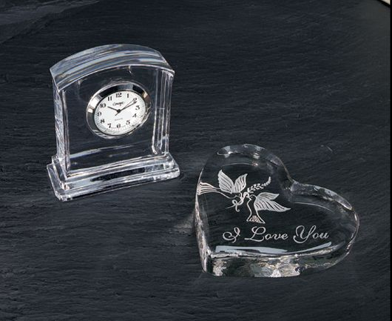
Love will outlast even faith and hope (13)
"Three things will last forever
–faith, hope, and love–
and the greatest of these is love."

Slide 56

Main Idea
Why must we use our gifts with love? Because…
love is superior to gifts, love benefits others, and love outlasts gifts

Slide 57

Black

Slide 58

How are you at loving others?

Slide 59
Black

Slide 60

Motive is Everything
"Ask not what a man does to determine whether his work is sacred or secular. Ask why he does it. The motive is everything. Let a man sanctify the Lord God in his heart and he can thereafter do no secular act" –– A.W. Tozer

Slide 61
Black

Slide 62


NT Preaching link at BibleStudyDownloads.org
Get this presentation and script for free!
Notes:
NT Preaching (np)

